Slide 1

East Asia Joint Symposium on Fields and Strings 2021@Osaka City University Nov. 22, 2021
Yang-Baxter sigma models
from 4D Chern-Simons theory
Dept. of Phys., Kyoto Univ.
Kentaroh Yoshida

Slide 2
0. Introduction

Slide 3
Our interest here
Construct a unified way to describe the 2D integrable models
Why is this issue so important? (My personal point of view)
In the study of integrable systems, integrable models are discovered suddenly
and when a certain amount of them have been obtained, beautiful universal
structures behind them are extracted such as Yang-Baxter equation.
Even now, new integrable models are being discovered one after another.
But we did not know a method to describe everything from the traditional
integrable models to the latest new types of models in a unified manner.
If this is compared to the study of elementary particle physics, the discovery of
an integrable model corresponds to that of a new particle, and its unified theory
corresponds to finding a unified model of elementary particles
(though this theory would be replaced by a larger new theory, subsequently,,,).

Slide 4
The candidate of the unified theory
4D Chern-Simons (CS) theory
[Costello-Yamazaki, 1908.02289]
c.f. Costello-Yamazaki-Witten,
1709.09993, 1802.01579
takes a value in Lie algebra of a semi-simple Lie group
: a 2D surface with the coordinates .
is a coordinate of .
: Chern-Simons 3-form
: a meromorphic 1-form
This 1-form is closely related to the integrable structure of
2D integrable sigma model (ISM) to be derived.

Slide 5
The recipe to derive 2D ISMs from 4D CS
1. Prepare a meromorphic 1-form.
The structure of poles and zeros determines the resulting 2D ISM.
2. Take a boundary condition for the gauge field .
Possible boundary conditions are governed by the equation of motion.
3. Reduce 4D CS to a 2D system by following a procedure.
There are some reduction methods. Take one of them as you like.
As a result, we see that the resulting 2D system is classically integrable
because the associated Lax pair can be constructed along this way.

Slide 6
The content of my talk
Explain how to derive 2D ISMs from 4D CS by taking a reduction method
developed by Delduc-Lacroix-Magro-Vicedo (DLMV)
[Delduc-Lacroix-Magro-Vicedo, 1909.13824]
1. A reduction method by DLMV
2. Concrete examples: 2D principal chiral model
Yang-Baxter sigma models
A brief summary of my related works
[Fukushima-Sakamoto-KY]
3. Summary and discussion

Slide 7
1. A reduction method by DLMV

Slide 8
A reduction method by DLMV
[Delduc-Lacroix-Magro-Vicedo, 1909.13824]
Our starting point:
,
: a meromorphic 1-form
This action has an extra gauge symmetry:
Hence the -component can always be gauged away:

Slide 9
Equations of motion:
(bulk eom)
Species of 2D ISM
(boundary eom)
Integrable deformations
NOTE 1 : If is smooth, the boundary eom is trivially satisfied.
But now
i.e.,
and hence a delta function may appear if has a pole.
NOTE 2 : From the bulk eom, the zeros of are also important
because a derivative of A may be a distribution, i.e., .
Let us introduce the following notation:
: set of poles of
: set of zeros of

Slide 10
NOTE3: The boundary eom has the support only on .
Indeed, it can be rewritten as
Here the local holomorphic coordinates are defined as
Lax form
Let us perform a formal gauge transformation:
Then the -component of can be removed as

Slide 11
Then the Lax form is given by
(to be identified with Lax of 2D ISM)
The bulk eom leads to
Flatness condition
NOTE: the set of zeros of is that of poles of
For simplicity, we assume below that has
at most first-order zero & at most double poles

Slide 12
The ansatz for Lax form
Here are smooth functions.
These functions are unknown functions at this moment and to be determined
from a boundary condition for the gauge field.
Later, we will see how to do it for 2D principal chiral model concretely.

Slide 13
The original 4D CS can be rewritten as
To reduce this 4D action to a 2D theory, let us suppose
the archipelago conditions:
There exist open disks for each such that and
i) If for all
ii) outside
depends only on and the radial coordinate
iv) depends only on , that is,

Slide 14
depends only on on the islands
Otherwise, (i.e., on the sea).
= Sea
:pole
:island

Slide 15
Master formula
Refined recipe to derive 2D ISM
1. Specify the form of ω
2. Take a boundary condition of A at the poles of ω
3. Fix the form of Lax form with the above information.
4. Finally, evaluate the above master formula.
2D ISM

Slide 16
2. Concrete Examples

Slide 17
1. Principal chiral model with Wess-Zumino (WZ) term
INPUT
A meromorphic 1-form
are double poles
are zeros
Boundary condition
The boundary condition of A at the poles of ω is

Slide 18
By using the Archipelago condition, the group element is restricted as
due to the gauge symmetry
Then the boundary condition can be rewritten as
Due to the second condition, in the Lax form should be zero.
Thus the Lax form is

Slide 19
Then, by substituting the Lax form into the first boundary condition, we obtain
Thus, the Lax form has been determined as
Finally, by putting this Lax form into the master formula, 2D action is given by
This is nothing but 2D principal chiral model with the WZ term.

Slide 20
2. Homogeneous Yang-Baxter sigma model
The 1-form is the same as the previous (but k=0 for simplicity)
But the boundary condition of A at the poles of ω is replaced by
Here R is a linear operator from satisfying
the homogeneous Yang-Baxter equation
It is useful to introduce the notation:

Slide 21
Lax form:
2D action:
Homogeneous Yang-Baxter sigma model
[Klimcik, hep-th/0210095, 0802.3518]
[Delduc-Magro-Vicedo, 1308.3581]
[Matsumoto-KY, 1501.03665]
My related works:
Generalization of the DLMV method to symmetric coset case
[Fukushima-Sakamoto-KY, 2005.04950]
Introduction of the grading automorphism
In particular, we have derived homogeneous YB deformed AdS₅xS⁵ superstring from 4D CS
[Kawaguchi-Matsumoto-KY, 1401.4855]
Sakamoto’s talk today
c.f. λ-deformation of AdS₅xS⁵ superstring from 4D CS
[Tian-He-Chen, 2007.00422]

Slide 22
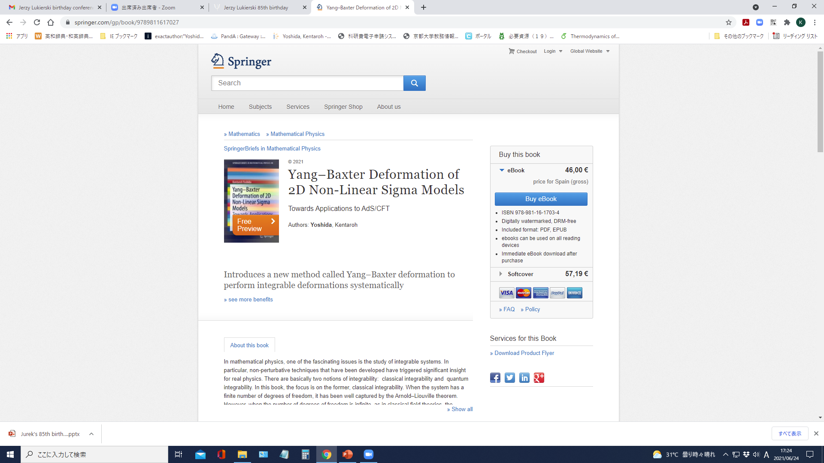

Slide 23
My other works
Generalization to include order defects
[Fukushima-Sakamoto-KY, 2012.07370]
[Fukushima-Sakamoto-KY, 2111.nnnnn]
We have derived the Faddeev-Reshetikhin model and non-abelian Toda field theories
including (complex) sine-Gordon model and Liouville theory.
Fukushima’s talk today
Derivation of Integrable T^{1,1} sigma model from 4D CS
[Fukushima-Sakamoto-KY, 2105.14920]
It is well known that the usual T^{1,1} sigma model is non-integrable.
[Basu-Pando Zayas, 1103.4107]
But recently, a modified T^{1,1} has been shown to be integrable.
[Arutyunov-Bassi-Lacroix, 2010.05573]
We have studied classical chaos apart from integrable points.
[Ishii-Kushiro-KY, 2103.12416]
Kushiro’s talk today

Slide 24
3. Summary and Discussion

Slide 25
3) Summary and Discussion
We have discussed how to derive 2D ISMs from 4D CS.
In particular, superstring on AdS₅xS⁵ is also included.
The origin of kappa-symmetry?
Kappa symmetry: A fermionic gauge symmetry in the Green-Schwarz formulation
of superstring theory which is based on space-time fermions.
It is necessary to remove the redundant space-time fermions.
But it was introduced in a heuristic way and its origin is unclear.
Take-home message
The unified theory of 2D ISMs may reveal
the fundamental symmetry of String Theory.

Slide 26
Thank you for
your attention!

Slide 27

But 4D CS scenario might be a tip of the iceberg!

Slide 28
Current understanding:
6D holomorphic Chern-Simons theory
Costello [talk at Strings 2020], Bittleston-Skinner [2011.04638]
? ? ?
Dihedral affine
Gaudin model
4D CS
4D IM
Costello-Yamazaki
Vicedo
e.g. 4D WZW model
Delduc-Laxroix-Magro-Vicedo
Laxroix-Vicedo
2D ISM

